Slide 1
Kelso’s Choices

Slide 2
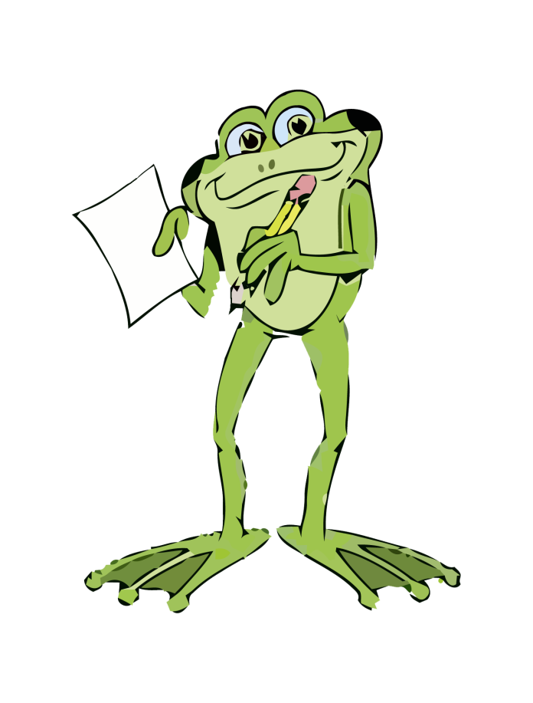
What It’s all about..
Kelso’s Choices empowers YOU to use
skills of conflict management
at school, in the community
and at home.

Slide 3
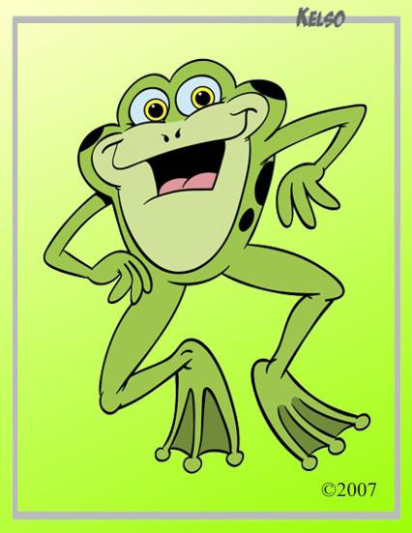
There are Two Types of problems…….
BIG PROBLEMS
* Scary
*Cause Worry
*Someone could or is getting hurt
*Break the law ( stealing, damage property, etc.)
small problems
* Angry
*Sad
* Embarrassed
*Annoyed

Slide 4
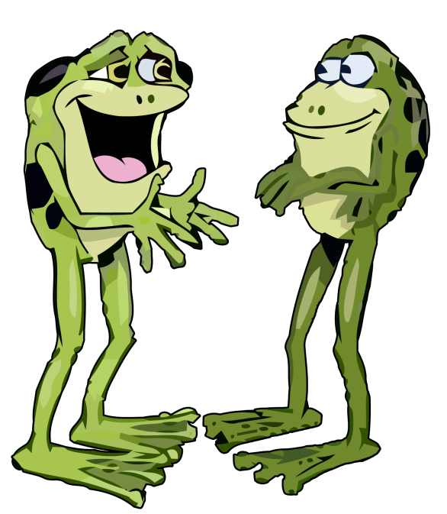
BIG PROBLEMS
“ Big problems need big help.”
Report BIG PROBLEMS
to a trusted adult right away!!!
Examples of BIG PROBLEMS:
A student is throwing rocks on the playground.
A student is writing on school walls.
A student is taking something from
another student’s backpack.
A student is roughly pushed down by
another student.

Slide 5
Small problems
Using Kelso’s Choices, YOU are big enough, smart enough and strong enough to handle small problems!
Examples of small problems:
Not sharing
Writing on your paper
Not sitting in the correct space
“jumping” line
Making noises during work time
Not following game rules

Slide 6
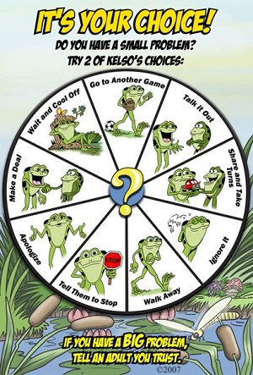
Kelso’s 9 Choices
Wait & Cool Off
Go to Another Game
Talk it Out
Share & Take Turns
Ignore it
Walk Away
Tell Them To Stop
Apologize
Make A Deal

Slide 7
Wait and Cool Off
When all else fails and a small problem has gotten you really upset,
wait and cool off.
Go to a quiet spot and think about how you can solve this problem peaceably.
Where can you go to
calm down and cool off…
at school?
at home?

Slide 8
Go to Another Game
Sometimes, even your favorite game can stop being fun because of others’ cheating or making their own rules as you play.
We can get “stuck” playing , even when we are no longer having fun! When there are too many small problems, it is time to
go to another game.
“ You are NOT a quitter. It just means you are smart and want to have fun!”

Slide 9
Talk it Out
Look at Kelso on the choice wheel….. If you talk it out, each person needs to explain their side (HINT: Use an I- message!) while the other person listens then they switch, so both people know how the other feels.
This choice will only work if the two friends are willing to listen to each other.

Slide 10
I- message
I – messages can help you communicate how you feel.
When you____________,I felt________________. Please_______________.
An I-message can be very powerful if you say the person’s name, use eye contact, remain calm, and use a steady voice.
Example: A classmate jokingly calls you a hurtful name.
I look at my classmate in the eyes and I say,
“Sally, when you called me a dork, it really hurt my feelings and made me feel frustrated. Please do not call me or anyone that again. It is not a joke and it is not funny.”
.

Slide 11
Share and Take Turns
We share a lot of things when we are here at school. Can you name some things we must share? Can you tell the procedure on what to do?
Sometimes, we have to be patient and wait our turn. We need to sit quietly and wait until the object we need to use is available.
What could be a consequence of not sharing and taking turns?

Slide 12
Ignore
To ignore means to not look or listen to something that can be distracting to you.
Notice Kelso on the poster…. He has a calm face and calm body and he is not looking or listening to what is distracting to him.
Remember that ignoring is not a quick way to solve a problem, but it still can work if you are patient and consistent.
When could ignoring be help solve a small problem?

Slide 13
Walk away
When you choose to walk away, you are simply moving away from someone who is distracting you. This choice often goes together with ignore.
When you choose to walk away to solve a small problem, you are not a “chicken”; your using your smarts!! You are being proactive! You are in control!

Slide 14
Tell them to stop
Telling someone to stop their actions can work to solve the small problem if you are polite and assertive- NOT whiny or mean.
For example: Someone keeps tugging your backpack as you walk down the hall.
Turn around. Look the person in the eyes and say in a quiet, firm voice, “Please, stop.” You may also choose to send an I- message along with telling them to stop.

Slide 15
Make a deal
When you choose to make a deal, you are making a bargain or a compromise. You may lose a little, but you can gain a lot.
Some students can agree to a compromise through the use of flipping a coin, rock-paper-scissors, etc.
What kind of deal could you make if…..
* You want to do a different activity at recess than your friends.
* You and a classmate both want to sit with the same person on the bus, but you are only allowed to sit 2 people per seat.

Slide 16
apologize
To choose to apologize is a meaningful and sometimes hard choice to make. Nobody likes to admit their mistakes. (NOTE: Sometimes we need to choose to wait and cool off before we can be ready to apologize.)
When you choose to apologize, you must be sincere and you should say what you are sorry for.
Words you can say:
“ Hey, I really didn’t mean it.” , “ Excuse me.” , “ I apologize.” , “ I should have…. and I am so sorry.”

Slide 17
Kelso and the seven habits of happy kids
When you choose to solve your small problems, YOU are in control! YOU are practicing Habit 1: BE PROACTIVE!
Because you are becoming familiar with Kelso’s Choices, you are preparing for conflict you may have with others so you are practicing Habit 2: BEGIN WITH THE END IN MIND.
You are PUTTING FIRST THINGS FIRST (Habit 3) when you take care of yourself and your success when you choose Kelso’s choices.
Habit 4 is to THINK WIN-WIN. This means you try to find the best possible solution for everyone.
Kelso’s choices consider not only you and your
feelings and your success, but also those
around you. This is thinking win-win!

Slide 18
ASCA NATIONAL STANDARDS (THAT COINCIDE)
Personal/Social Domain
Standard B: Students will make decisions, set goals and take necessary actions to achieve goals.
PS:B1.1 Use a decision-making and problem solving model
PS:B1.2 Understand consequences of decisions and choices
PS:B1.3 Identify alternative solutions to a problem
PS:B1.6 Know how to apply conflict resolution skills
Standard C: Students will understand safety and survival skills.
PS:C1.5 Differentiate between situations requiring peer support and situations requiring adult professional help
PS:C1.7 Apply effective problem-solving and decision-making skills to make safe and healthy choices
PS:C1.10 Learn techniques for managing stress and conflict

Slide 19
Resources
www.kelsoschoice.net
www.sdteach.com/Kelso_s_Choice_Program_p/101636.htm\
American School Counselor Association (2005). The ASCA National Model: A Framework for School Counseling Programs, Second Edition. Alexandria, VA: Author

