Slide 1
Kelso’s Choices Conflict Resolution

Slide 2
Big and Small Problems
Sometimes YOU can handle a problem or conflict.
Other times you need an adult’s help.
How can you tell the difference?

Slide 3
Small Problems
These are problems that you are strong enough and smart enough to handle on your own.
These conflicts you can solve without an adult’s help.
Small problems often happen when an adult is not around (bus stop, bathroom, at home).

Slide 4
Big Problems
Problems or situations that are dangerous or scary need adult help to solve.
Big problems can result in someone being hurt.

Slide 5
Big or Small Problem?
Small: hold your fingers one or two inches apart
Big: hold your hands far apart

Slide 6
A student is …
Making noises when you are trying to work
Small
Passing notes about you
Small
Playing with matches
Big
Cutting in line
Small
Writing on the walls
Big

Slide 7
A student is …
Whispering during a movie
Small
Not sharing a toy
Small
Carrying a knife
Big
Being hit or kicked at recess
Big
Calling you silly names
Small

Slide 8
A student is …
Taking your pencil without asking
Small
Stealing from a teacher’s desk
Big
Using bad words (cursing)
Big
Spreading a rumor
Small
Taking too long at the water fountain
Small
Throwing rocks
Big

Slide 9
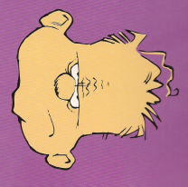
Feelings give clues
How do Small Problems Feel?
Distracting noises
Passing notes
Cutting in line
Whispering during class
Calling you silly names
Not sharing a toy
Spreading a rumor
Taking your pencil without permission

Slide 10
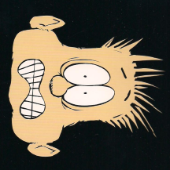
Feelings give clues
How do Big Problems feel?
Playing with matches
Writing on the wall
Carrying a knife
Hitting or kicking
Stealing from teacher’s desk
Using curse words or bad language
Throwing rocks

Slide 11
Tattling or Telling?
“Tattling” is:
when a student tries to get someone in trouble and doesn’t really want to solve the problem.
“Telling” is:
when a student asks an adult to help resolve a BIG problem.

Slide 12
BIG Problems
Which adults can you tell?
Parent
Bus driver
Relative
Principal
Teacher
Counselor
Friend’s parent
Coach

Slide 13
BIG Problems
What can you do if there are no adults around to share your problem with?
Questions about handling BIG problems?

Slide 14
Small Problems: Try Two of Kelso’s Choices Before Telling an Adult

